Slide 1
Zia’s Pizza App Usability Study
1/27/2021
UX Analysis Team
April Appmaster Davis Developer
Cameron Coder

Slide 2
Table of Contents
Section 1 Study Details
Section 2 Themes
Section 3 Insights & Recommendations

Slide 3
Study Details

Slide 4
Project Background
We’re creating a Zia’s Pizza app to attract and retain customers in our online system. We noticed that our competitors offer dedicated mobile apps for their customers to order through, and they have been very successful. We want to create a product that can compete in the market, improve sales, and increase customer satisfaction.

Slide 5
Study Details
Research Questions
Participants
Methodology
How long does it take for a user to select and order a pizza in the app?
Are users able to successfully order the pizza that they want?
What can we learn from the steps users took to order a pizza?
Are there any parts of the pizza ordering process where users are getting stuck?
Is the payment process easy for the customer?
7 participants
Participants between the ages of 18-62 who reside in metropolitan and suburb areas. Participants order out at least once a week.
25-30 minutes
United States, remote
Unmoderated usability study)
Users were asked to order a pizza on a low-fidelity prototype

Slide 6
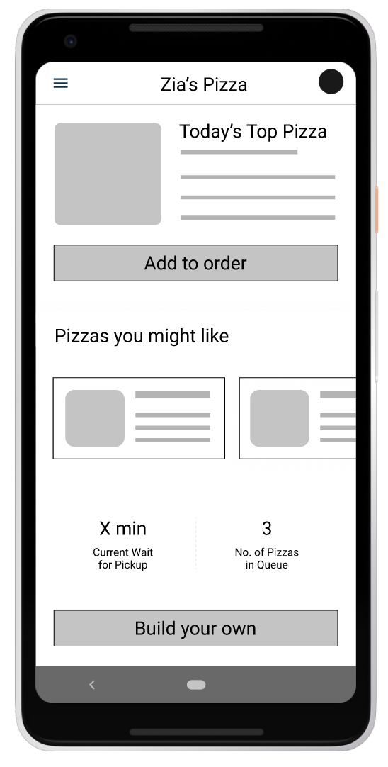
Prototype Tested
The low-fidelity app prototype for Zia’s Pizza was tested and can be viewed here.

Slide 7
Themes

Slide 8
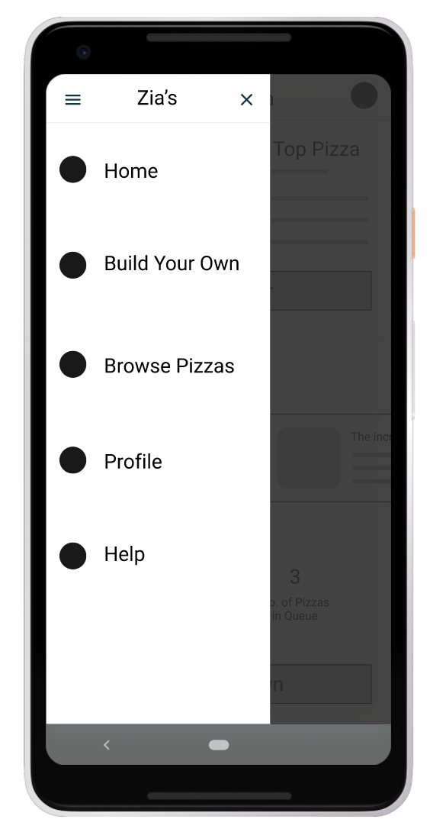
People want to order pizza quickly
Supporting evidence from the usability study.
5 out of 7 total participants said they wanted to order their pizza in under five minutes
4 out of 7 total participants expressed a desire to save orders for easy re-ordering
“I like the profile feature, but it’s strange that there’s no way to store my order so I can order it again next time.”
— Alan East, pizza consumer from Denver, Colorado
a

Slide 9
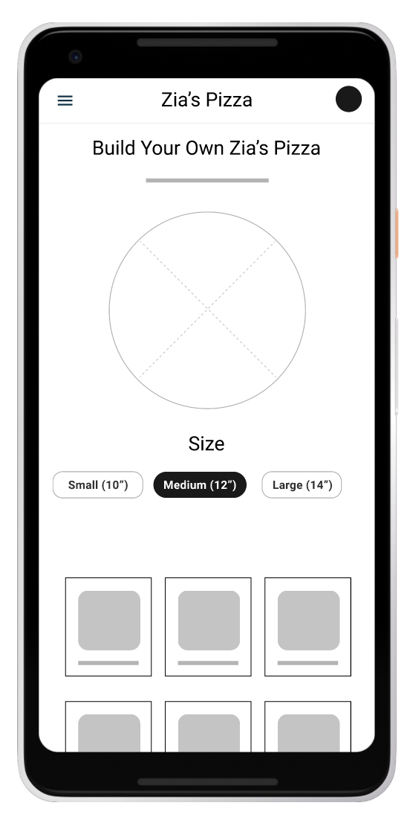
People want customization options
Supporting evidence from the usability study.
4 out of 7 total participants said they wanted the ability to choose crust and sauce in addition to toppings
3 of those participants noted that they would like an option for gluten-free or low-calorie crust options.
“I’m gluten-intolerant, so I would really like the option to choose a crust that meets my dietary needs.”
— Noemi Hirsch, pizza consumer from Boulder, Colorado
a

Slide 10
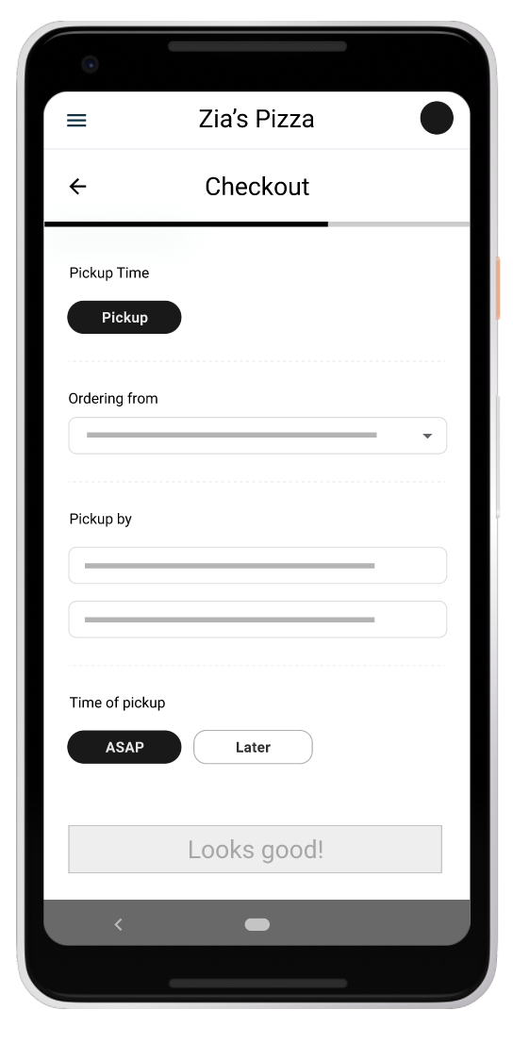
People want a delivery option
Supporting evidence from the usability study.
6 out of 7 total participants said they wanted an option for delivery in addition to pickup
“With my busy schedule it’s not always easy to drive to the store and back. Sometimes I just want to kick back, relax, and get some food delivered. Easy.”
— Ky Lim, pizza consumer from Highlands Ranch, Colorado
a

Slide 11
Insights & Recommendations

Slide 12
Research insights
Fast ordering
Customization options
Delivery option
Users need a way to order more quickly without having to go through the full “Build a pizza” process..
Users need better customization options when building their own pizza.
Users need a way to order food for delivery.

Slide 13
Recommendations
Add a “save pizza” option in the user profile so users can reorder quickly.
Add a way for users to customize their sauce and crust so they have expanded options for their dietary needs and preferences.
Add a delivery option in the checkout process so users can order from the comfort of their home.

Slide 14
Thank you!

